Slide 1
Task 1 – Seismic inversion

Slide 2
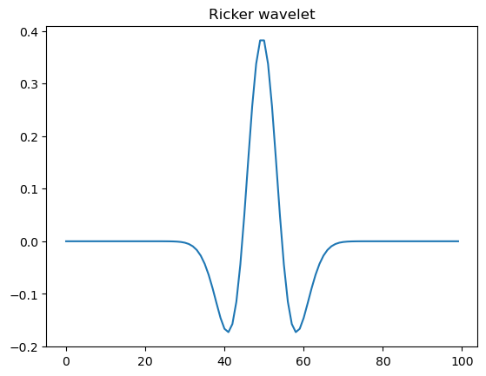
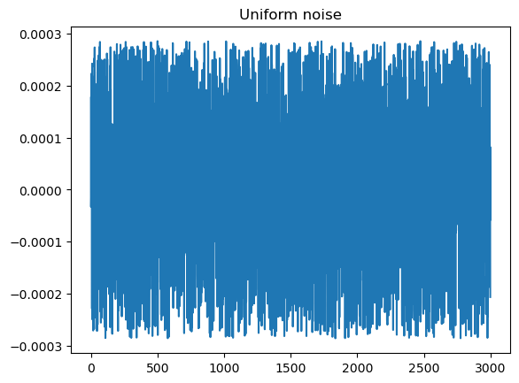

Methodology
Wavelet used to create “field signal”
Noise used to create a noisy reflectivity profile
Error between measurements

Slide 3
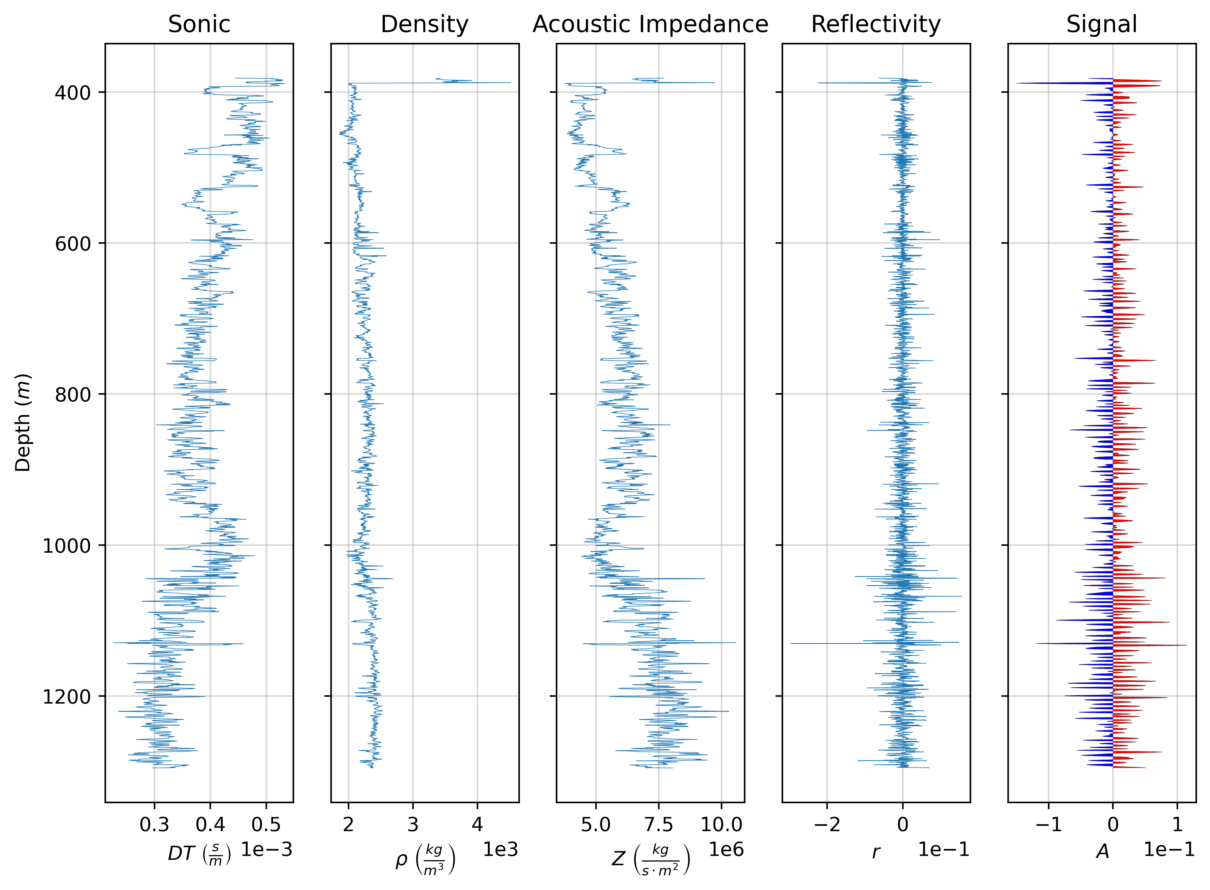
Ground truth

Slide 4
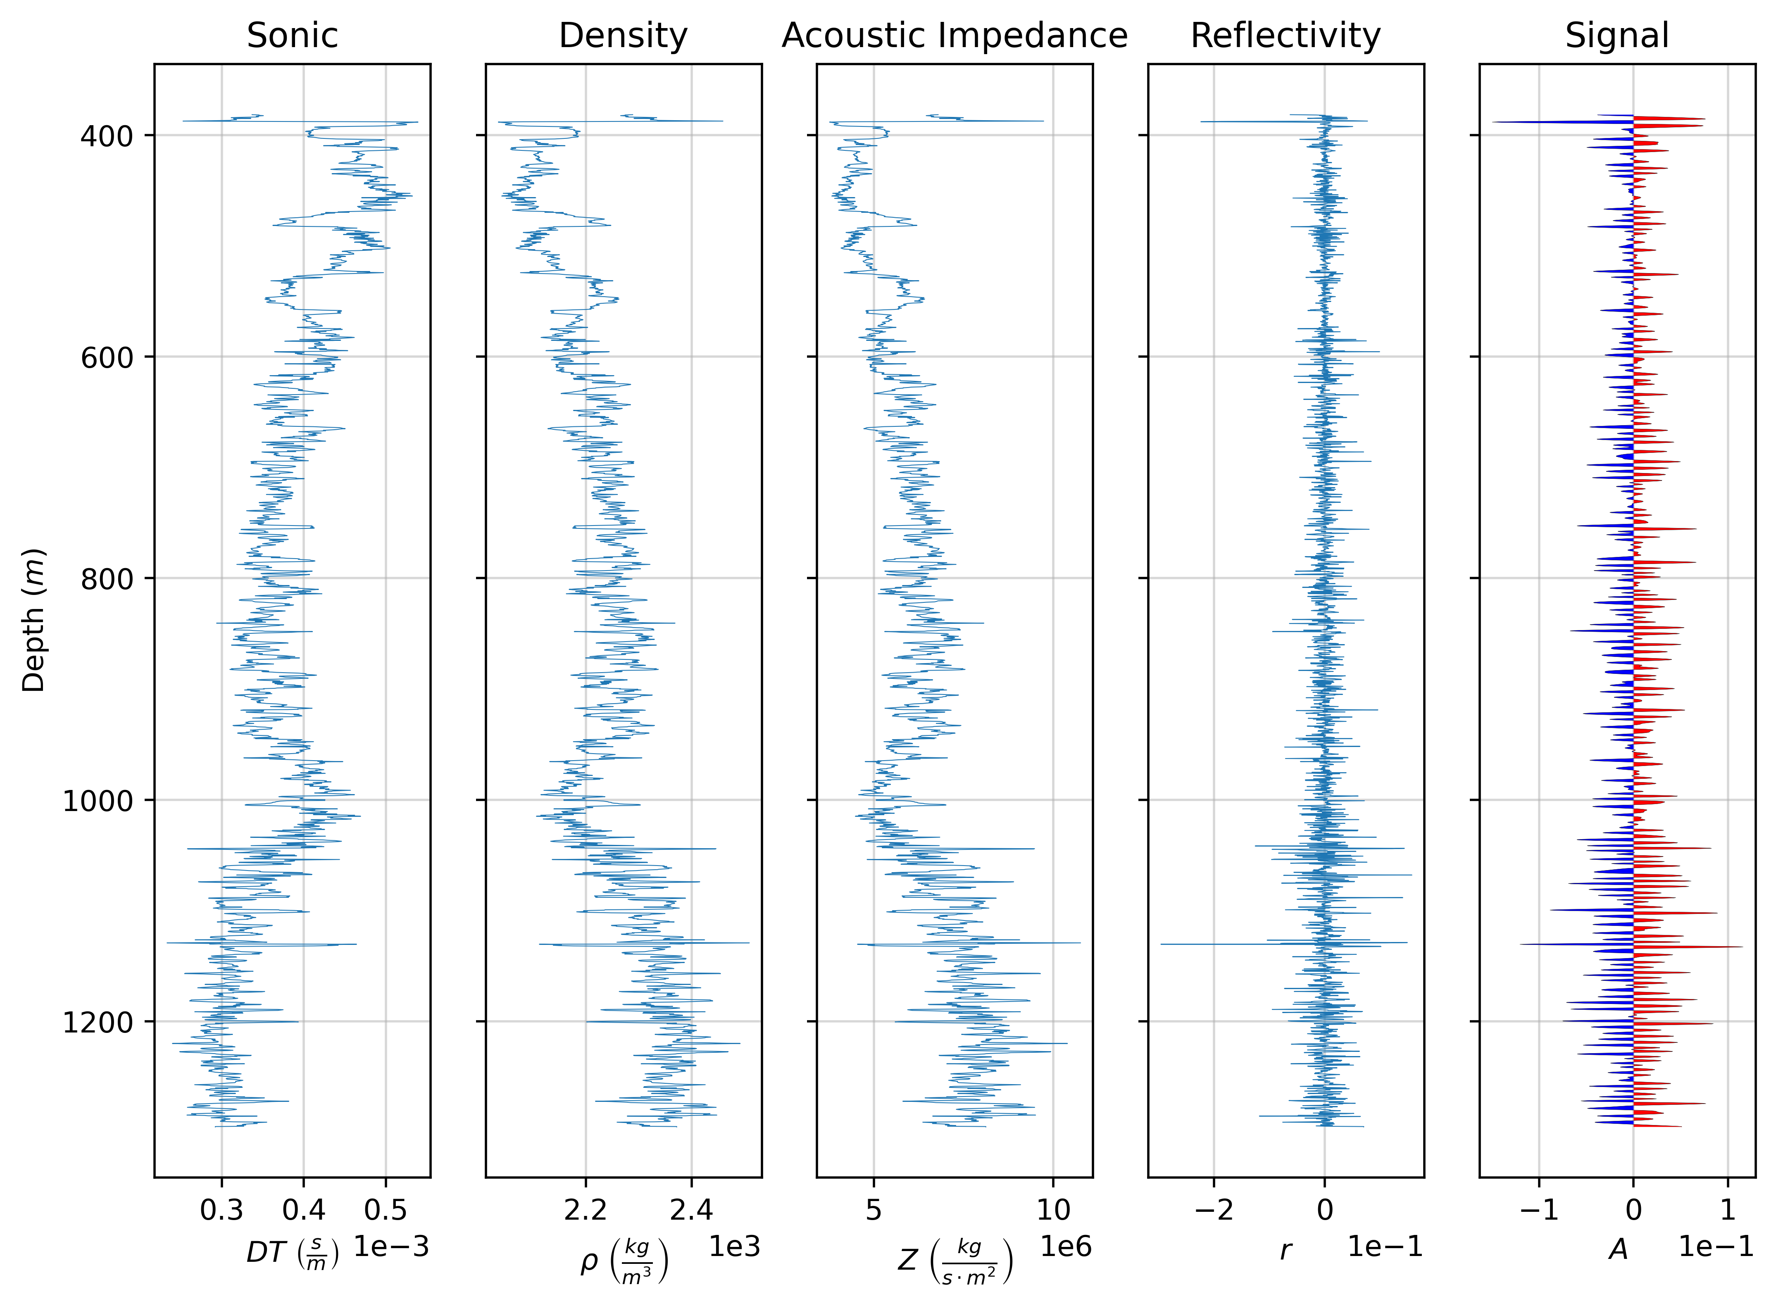
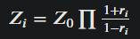
Method 1: Recursive inversion
Error for Vp: 2.18 %
Error for rho: -0.74 %
Error for Z: 1.24 %
Overall error: 0.89 %

Slide 5

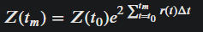
Method 2: |r| < 0.3
Error for Vp: 3.17 %
Error for rho: -0.5 %
Error for Z: 2.46 %
Overall error: 1.71 %

Slide 6
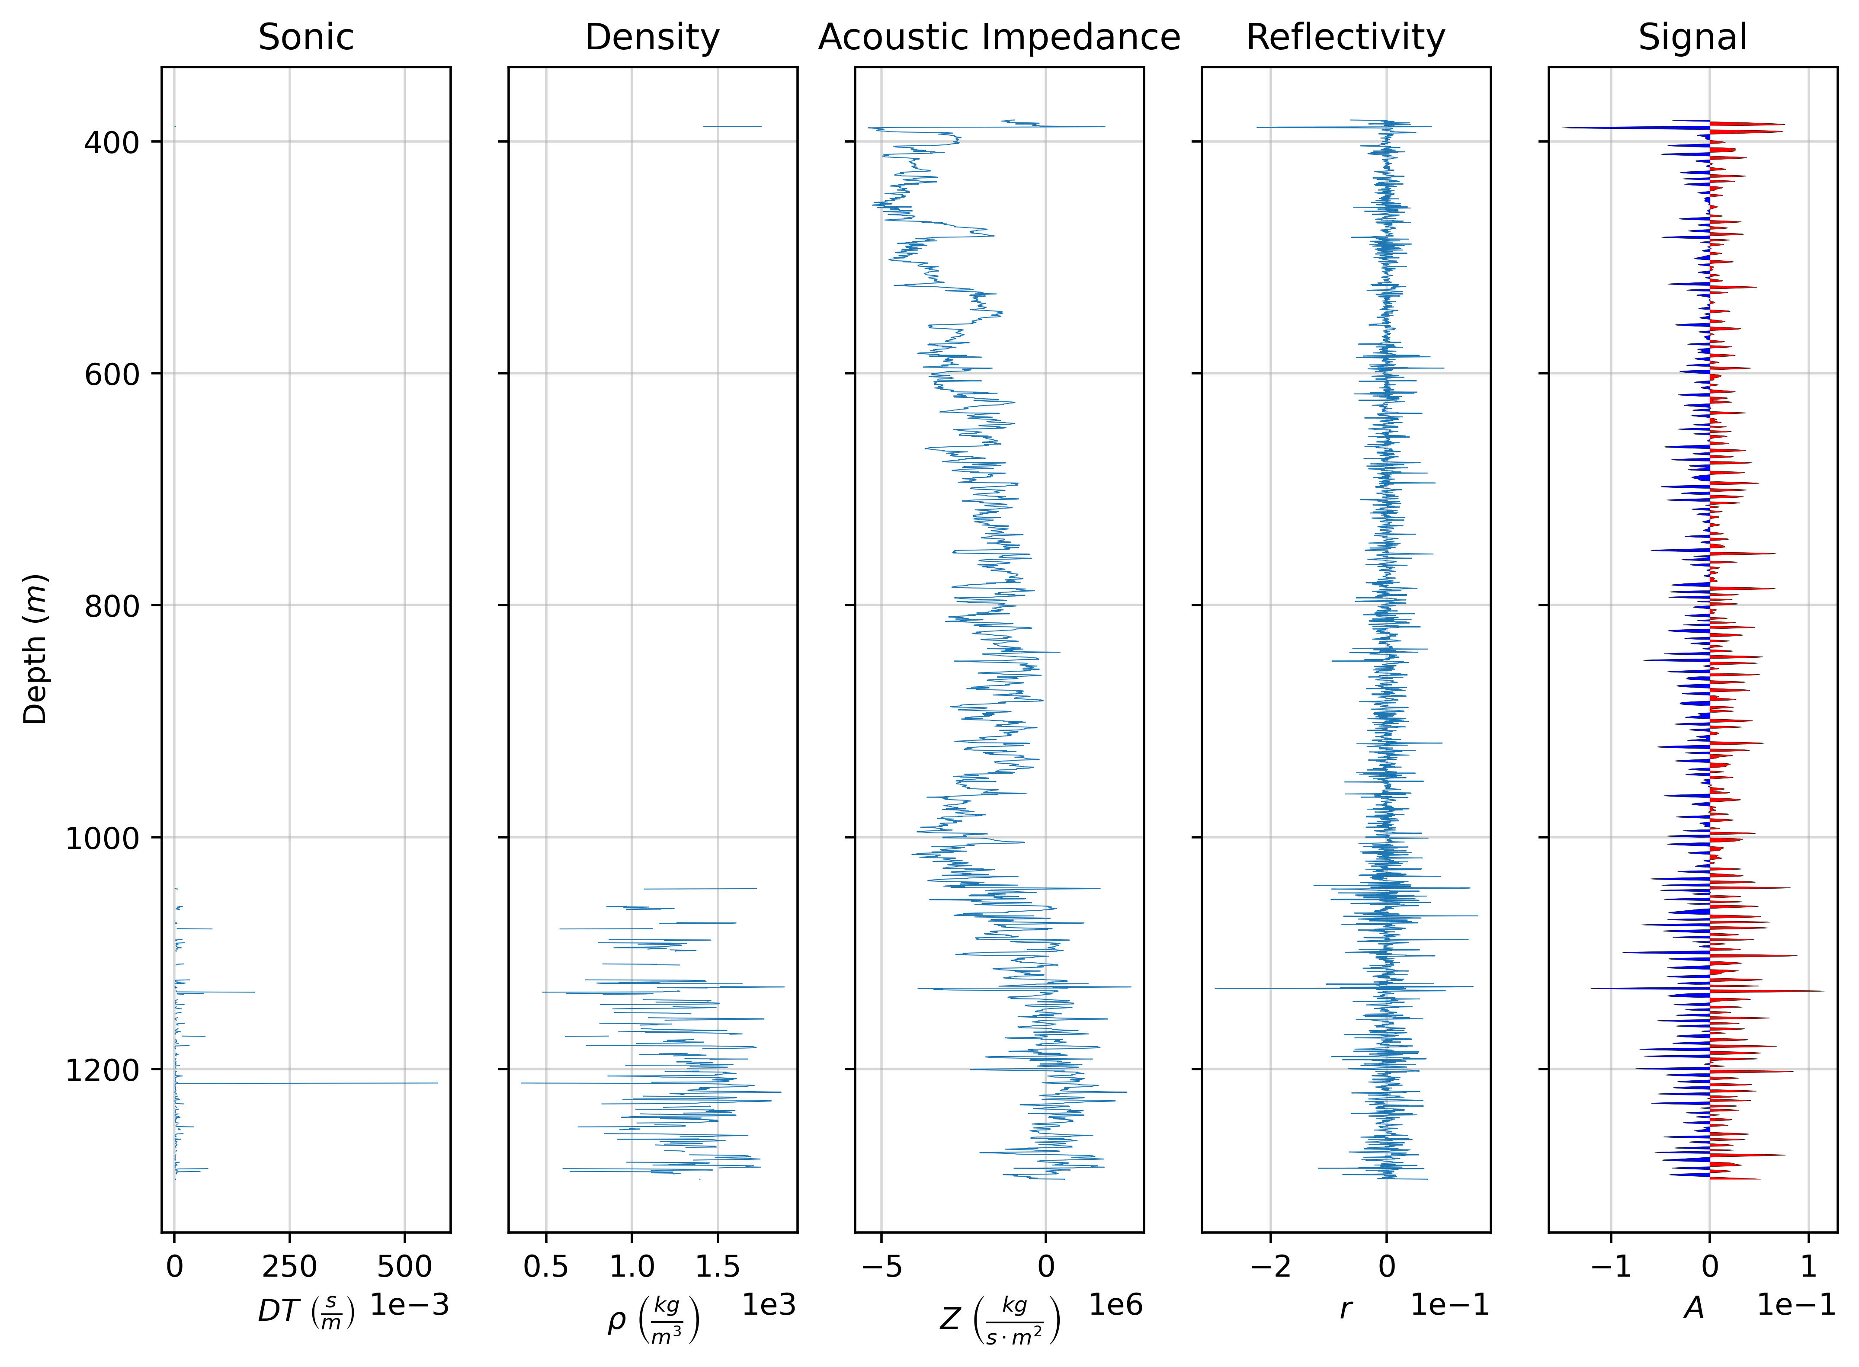
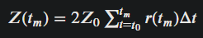
Method 3:|r| < 0.1
Error for Vp: -88.27 %
Error for rho: -45.07 %
Error for Z: -134.32 %
Overall error: -89.22 %

